Slide 1
Green Charger
Project by
Akash Nishar
Jasleen Kaur
Debayan Roy
Neelam Soni
Sagar Jaishwal
Navin Sharma
Sumit Kulkarni

Slide 2
Top Ideas
Water Purifier Bottle
Spoon ‘n’ Fork in single utensil
Beer Chillers
Wind Powered Mobile Charger

Slide 3
Executive Summary
The Project is on the wind chargers for charging mobile ph0nes in remote areas.
The Product is totally new and has no competition.
The Product is eco-friendly and cheap so the people in villagers and travellers can be easily targeted.
The Product can generate a good amount of profit.

Slide 4
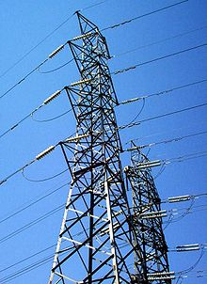
Pain Area
Electricity in Rural Areas
Travellers Need
Fisherman’s Need

Slide 5
Impact
Mobile charging issues of rural area people will be solved to some extent
Travellers will have mobile battery backup so that they can basic as well as advanced functions of mobile
Fisherman can stay in contact even if they go fishing whole day
People limit their usage of mobile while travelling, but if charging gets available then they can have prolonged usage

Slide 6
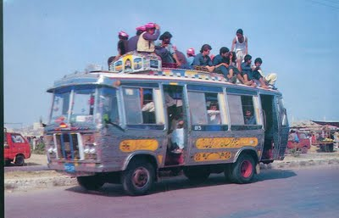
Market
Rural Areas’ people
Travellers
Fisherman

Slide 7
Fish-bone Analysis
Unavailability of Electricity
Battery Backup of Mobile
Insufficient or Lack of ____
Ports in bus
Power supply issues _________
Calls and SMS _________
Signal Capturing ________
Advanced uses like GPS___
Charging Problems
Ignorant transport service ______
providers
Not enough resources____
Affording luxury buses_____
Carrying Extra Batteries____
Service system issues
Financial Issues

Slide 8
No charging point in public transport
12% Indian travel 40hrs a week
Many gadgets have poor battery backup
Use solar energy
Use wind energy
Carry extra batteries
Extract energy from automotive batteries
Solar, wind are eco-friendly and free
Portable device can be made using current technology
While travelling, wind reduces when vehicle stops or runs at low speeds
Solar not available for night travelling
Batteries are costly
It is good if something can be done in harmony with nature

Slide 9
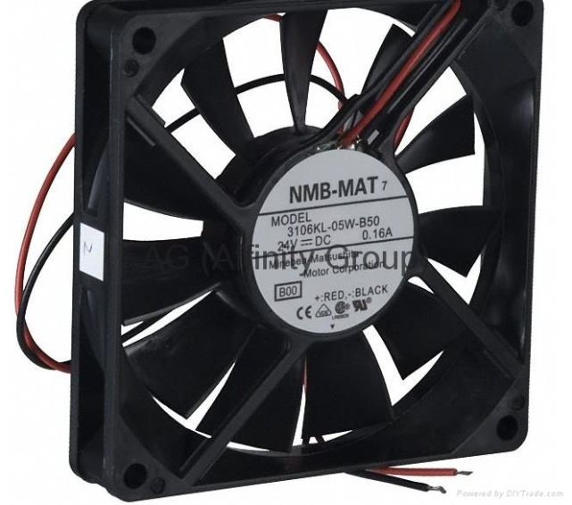
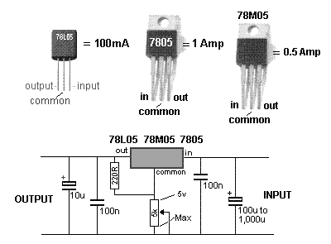
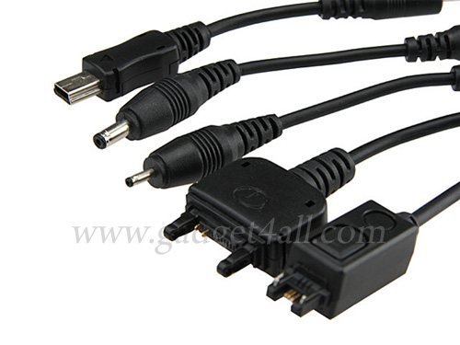
Cooling Fan
Regulator Circuit
Charge Mobile

Slide 10
Financial Help
Estimated Product Cost Fan: Rs. 40
Electronic components: Rs. 30-35
Packaging: Rs. 10
Transport And Overhead Charges: Rs5-10\ Piece
Distributors and Retailers' Profits : Rs. 10 each
Estimated MRP: Rs. 120
First Batch of 1000 pieces will require a capital of 100,000.
The venture will be self financed.
Finance: Initial investment of Rs. 14500 (Approx.) from each member of the team.

Slide 11
Marketing
Publicising the product by putting up posters in buses and local trains in the target region.
Distributing pamphlet near bus stations and railway stations.
Demonstrating as well as sale of the product in Buses and trains by travelling hawkers.

