Slide 1
VAP
(Vote Any Place)
System
By
Asif Pathan
Lokesh
Gowtham
Lavanya

Slide 2
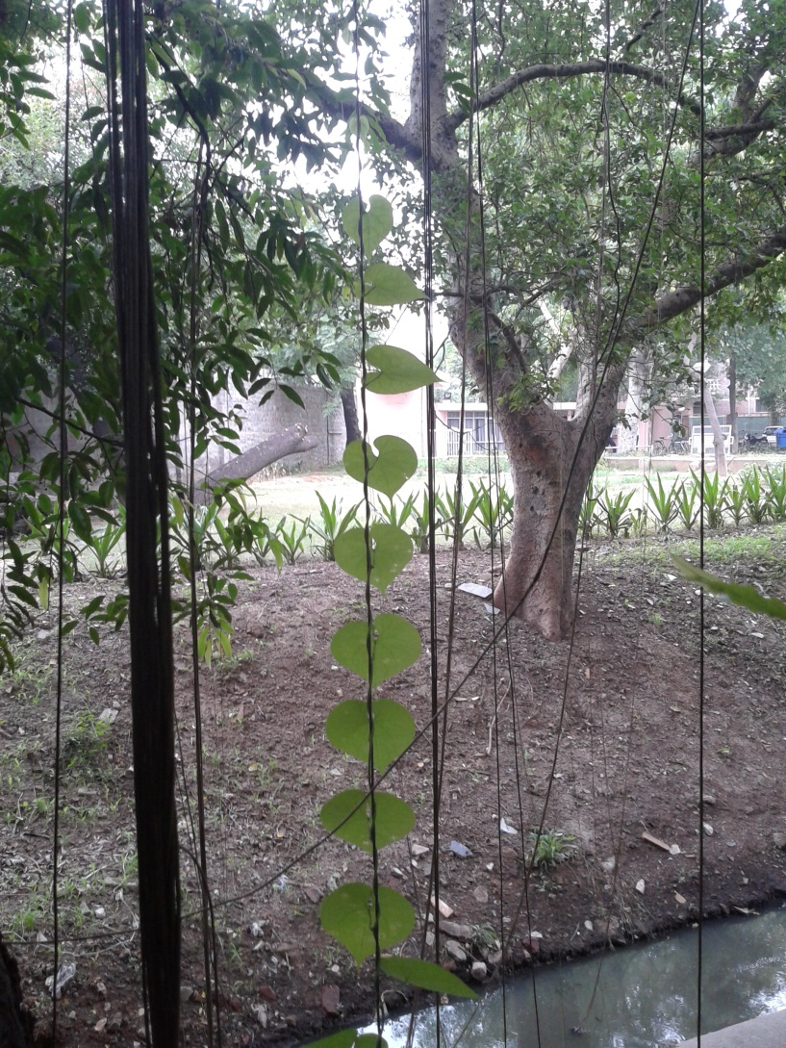
Leadership & Teamwork

Slide 3
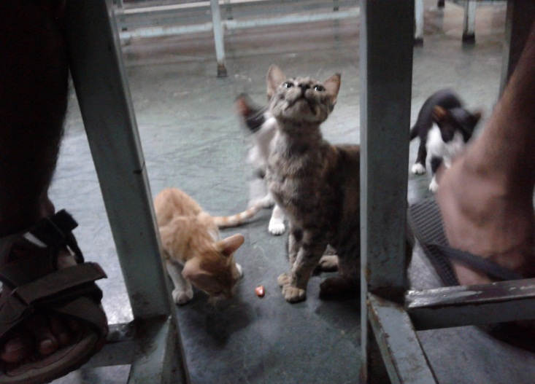
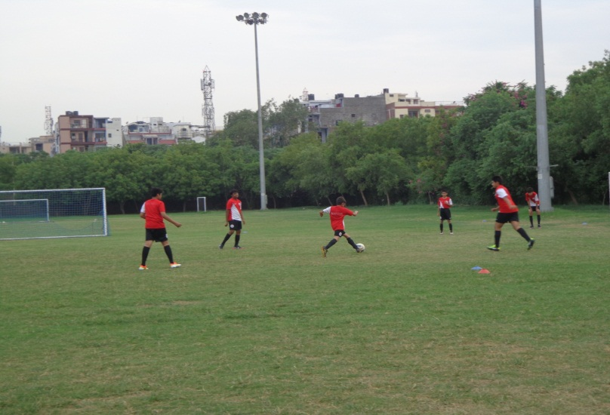
Leadership
Teamwork

Slide 4
IDEAS
Criminal tracking system
Wall–O–Thum(Replacing Wallet with Thumb)
Smart voting machine
Simplified travel plan using Aadhar

Slide 5
PROBLEM
Indian Election Commission needs to implement the electronic voting system using Aadhar system and Thumb impression because it has to overcome the flaws in the voting system.

Slide 6

FISHBONE
FISH BONE
Not secure
Results delayed
Theft of box
VOTING SYSTEM INEFFECTIVE
Bogus voting
Restricted
to an area
Multiple Database

Slide 7
BENEFITS
Bogus voting can be eradicated
Accessible from all parts of the country
More secure
Time efficient
Same database

Slide 8
FEATURES
Retina scanner : Iris detector
Finger print scanner
For blind people :
Keypad for entering the choices.
Voice box to accept the commands.

Slide 9
Flow chart
Insert the card
valid
yes
scan
vote
no
Invalid voter

Slide 10

TECHNICAL REQUIREMENTS

Slide 11
How it works…………………
People staying in place other than their current venue of voting could approach the local collectorate .
Their Aadhaar card will be verified and allowed to access the EVM.
The specific parties of their wards would be displayed on screen once they once they press their thumb on the scanner.
The vote is then casted for desired party.

Slide 12
HELP
Election commission of India should bring out a policy such that Aadhaar database must be made as a part of voting process.
The collectorate should make arrangements to place the voting machine in a specific place in their district.

Slide 13
ESTIMATE
Including the retina scanner, thumb scanner and the keypad , the touch screen voting machine costs about 50,000 INR.

Slide 14
FUTURE PROSPECTS
It is possible to increase the voting percentage
by implementing this voting machine and by
further improving it, the system could reach
100 % of voting.

