Slide 1
Group 7

Slide 2
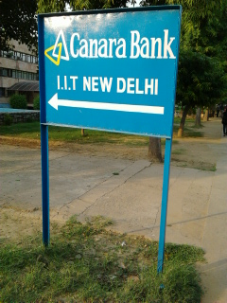
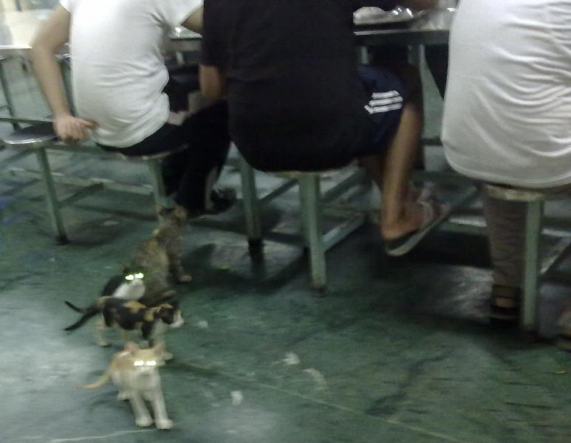
Team Work

Slide 3
Jugaad

Slide 4
The top 3 Ideas…
Use of Aadhaar Card to facilitate the process of
Job and Admission Applications.
Use of Aadhaar Card to enforce Pollution Checks
on vehicles.
Use of Aadhaar Cards for ensuring Payments of
Income Tax.
WINNER

Slide 5
Problem Statement
The people of India need a more reliable and efficient system because of the problems in the current system of applying to jobs and institutes.

Slide 6
Executive Sumary
The idea is to use UID (Aadhaar) cards to simplify the process that is required for most admission and application processes. This will be done by integrating a person’s academic data along with other recognized achievements with the Unique Identification Authority of India’s (UIDAI) database. This will enable the submission using a barcode and/or a number instead of the current process which involves much paperwork and allows for less authenticity.

Slide 7
Benefits
Impacts a Large Population
Only a Number does it all
Saving Resources
More Reliable
Less Hassle
Greater Transparency
Generating Employment

Slide 8
Decision-Making Tools

Slide 9
Fishbone Diagram
Resources
Human
Human Errors
Misuse of Information
Wastage of Paper
Wastage of Money
Difficulty in applying for jobs and admissions
Processes
Reliability
Slow Process
Requires More Effort
Difficulty in Access
Lack of Transparency
Authenticity of Documents

Slide 10
Six Thinking Hats
Most job and admission applications require academic and other data Lakhs of people apply for jobs and admissions each year | It impacts a large population It only requires a number for processing It saves resources such as paper, money etc. It is a more reliable system Less effort is required | Data needs to be updated on a regular basis Ambiguity in verifying authority Loss of privacy | Regular update possible after every 6 months An update can be scheduled earlier if required on extra charge Specific office will be set up for this purpose | Greatly appreciated by targeted public Satisfaction with the process Apprehension about leaking of information online

Slide 11
Processes

Slide 12
Process for Adding/Updating Data
Book an appointment with UIDAI
Take original certificates to UIDAI centre
UIDAI officer uploads all possible certificates onto database
A nominal charge is applied per uploaded certificate
All certificate information is added to the UIDAI database under proper account
A date is assigned (after 6 months) after which another update can be booked

Slide 13
Process for Employers/Institute
Applicant seeker enrolls self with UIDAI system
The required eligibility is established by the employer/institute
A gateway to UIDAI is created on the employer/institute’s website
An amount is collected by UIDAI for its services

Slide 14
Process for Applicants
Accesses the UIDAI gateway at employer/institute’s website
Provides UID number on the gateway
UIDAI system checks if applicant is eligible
UIDAI sends required data to employer/institute
Y
Decision to apply
Y
Eligible
N
N
Final application is made after financial transfer is made to employer/institute (if required)
Process terminates

Slide 15
Basic Requirements for the Project
A centre for document verification (2 per state in initial phases)
Biometric scanners for all the centers for uploading information to correct identity
Biometric scanners for employers/institutes to verify identity (optional)
Machinery that can accurately read and process given information on certificates
Authorities which are a part of UIDAI that can ensure smooth processing (software, updating etc.)

Slide 16
Future Prospects
Expansion of system for general public
Addition of other features e.g. resumé
Regular update can be used for statistical data about the population

