Slide 1
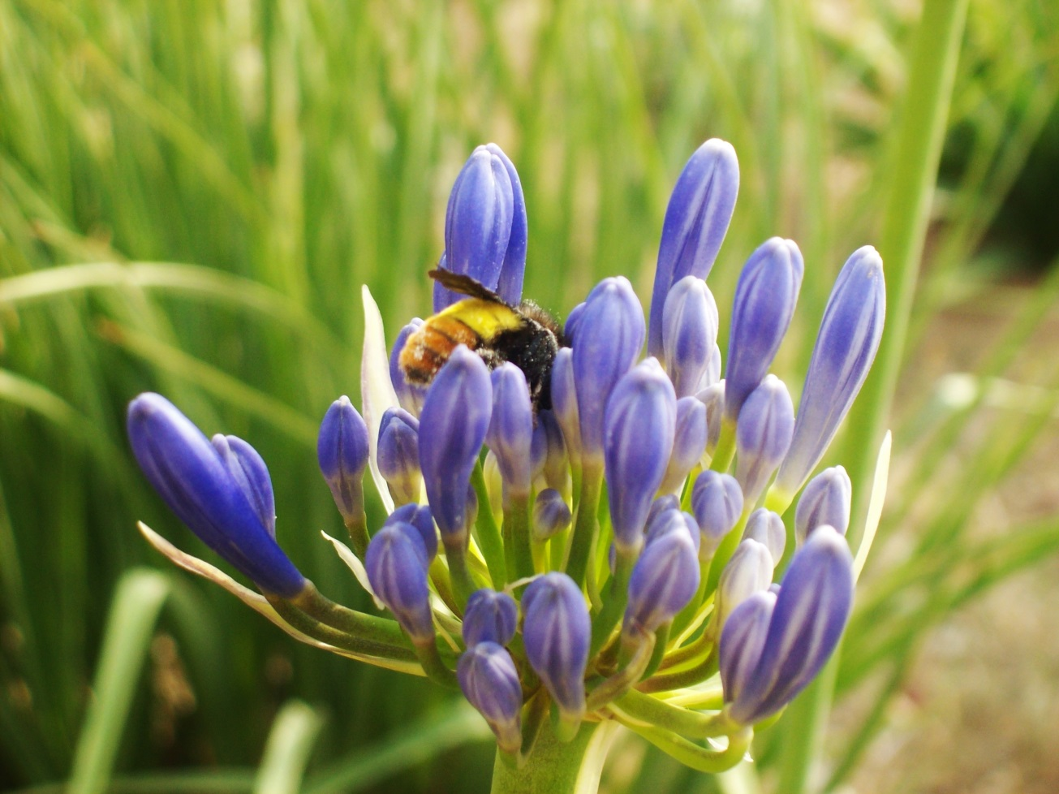
The flowers provide nectar whereas the bees help in pollination.
A beautiful example of symbiosis or teamwork in nature.

Slide 2
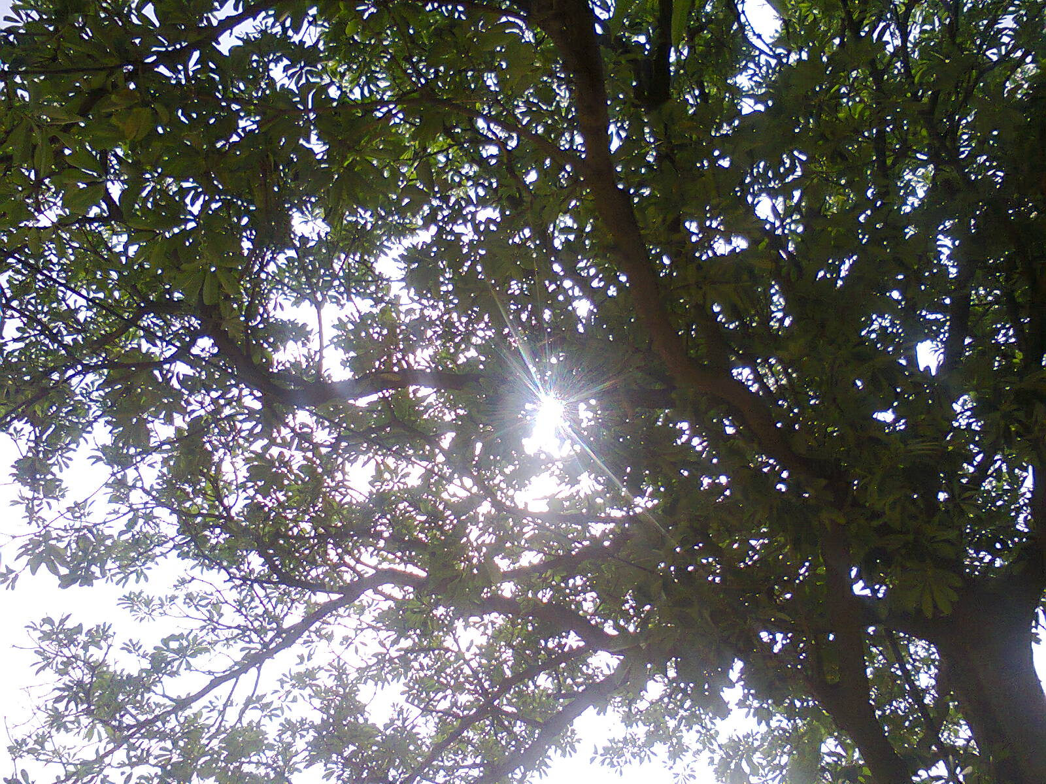
Leaves on a tree work together to stop the sunlight from falling on the ground. Another great example of teamwork in nature.

Slide 3
AADHAAR BASED VOTING SYSTEM
GROUP 4 (SUJITHA,PARAS,ISHU,SAMERTH)
NCAT 2013 CEP COURSE

Slide 4
Top Ideas
1. Aadhaar based voting System
2. United Public Transport System
3. MNREGA identification system
4. Application in banking Sector

Slide 5
Best Idea
. Aadhaar based voting System
Problem statement:
Indian Voting system needs a procedure to reduce illegal voting because of the increase in this malpractice.

Slide 6
Benefits And problem Addressal
1.TOI 24 Jan, 2009 11 lakhs fake votes in Delhi
2.India News June 2013 : Election commission has found 30000 illegal voters in the constituency of Sheila Dikshit. In total 1358179 voters have been found illegal in Delhi.
3.LJP(Lok Janshakti Party)
Chief, Ram Vilas Paswan alleges: 30% voter- cards fake in Bihar

Slide 7
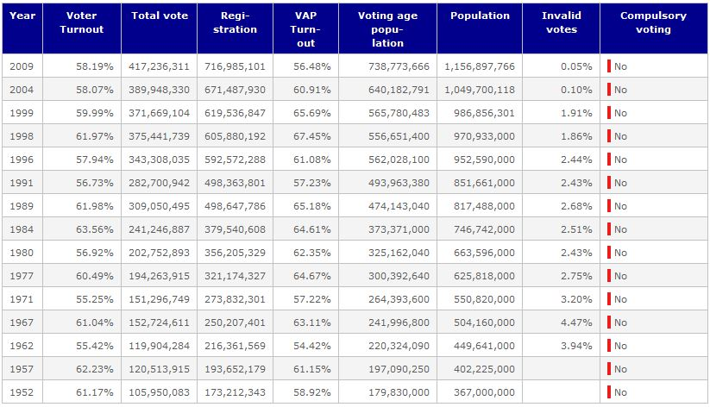
1952-2009 polls information

Slide 8
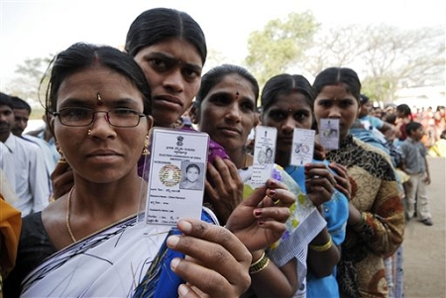
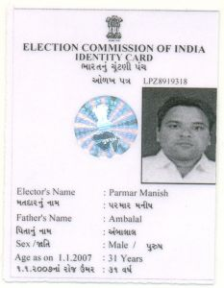
Benefits
Takes voter ID card out of the equation
Eliminates casting of fake votes

Slide 9
Parties
Voters
Corrupt politicians
Misuse of funds
Forceful voting
Illiteracy
Ignorance towards
Politics
Violating rules
Use of violence
Fake Votes
Tampering OF EVMS
Machines
FISH BONE ANALYSIS

Slide 10
Six Thinking Hats
White Hat | RED Hat | Yellow hat | Black Hat | Green Hat
India is the largest democracy In 2009, 714 million voters were registered. 6,87,412 polling stations are present. . | PROUD: that India is the biggest democracy DISAPPOINTED: that the electoral system isn't transparent enough. | provides authenticity and reliability to the system. | Cannot eliminate tampering of EVMs | Attach biometric scanners and barcode readers with the EVMs. Send SMS/ e-mail to registered mobile numbers after the vote has been cast.
Blue Hat Conclusion: The idea seems good enough. This will eliminate illegal voting and the voters will have more faith in the system.

Slide 11
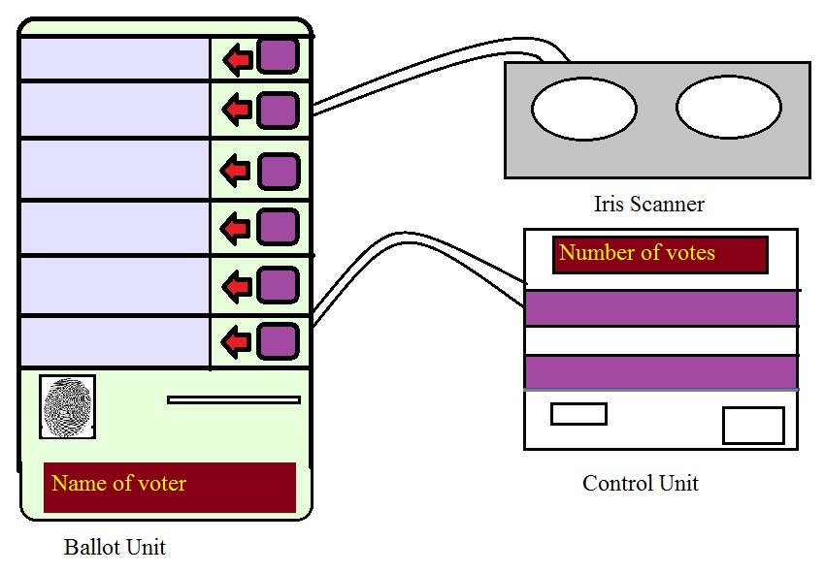
The product
Insert card here

Slide 12
Features of the concept
Instead of the voter ID card, AADHAAR cards used for identifying the voter
The voter inserts the card into the Barcode scanner.
Then verify his thumb prints
Also, identity is verified through iris scanner for maximum accuracy.
Finally, he is allowed to cast his vote by pressing the corresponding button on the machine

Slide 13
Help needed
Permission from EC to change the EVM design
Hardware such as Biometric scanners required
Help from firms to assemble the machine.

Slide 14
Future Prospects
Problem of illegal voting persists in every democracy. If an all-inclusive database, such as AADHAAR system, exists in those countries then we can implement this project in those markets too.

Slide 15
Thank you.
Queries and suggestions are welcome!

