Slide 1

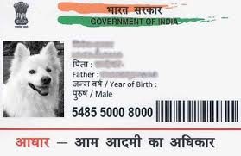
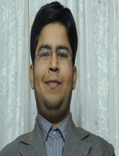
Group 3
Course on Creativity and
Innovation
NCAT 2013
PROJECT ON CREATIVE USES OF AADHAAR (UID) CARD.
@ DMS - IIT Delhi
1st to 6th July ,2013

Slide 2

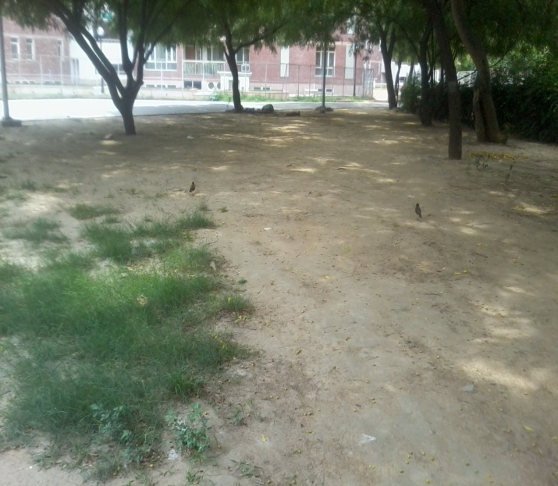
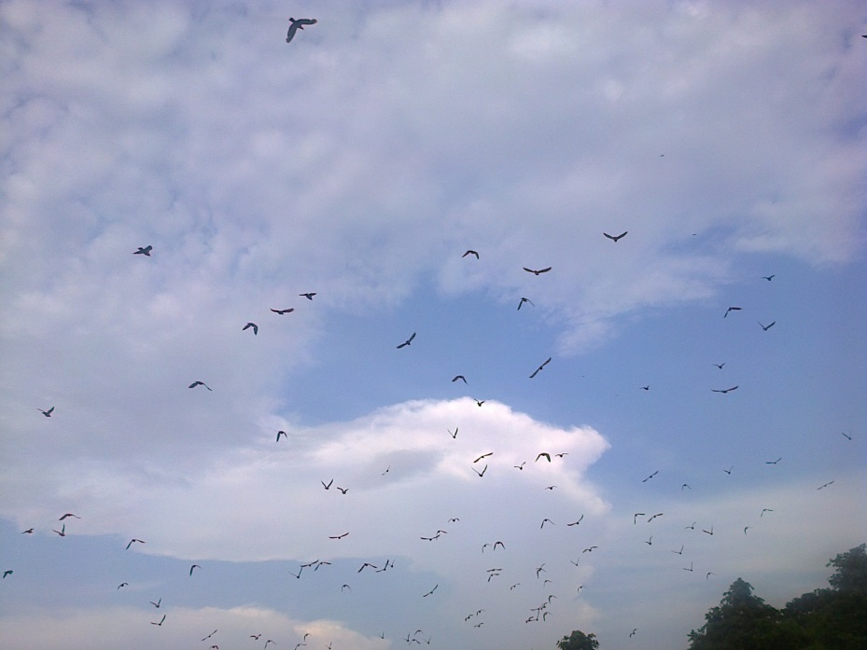
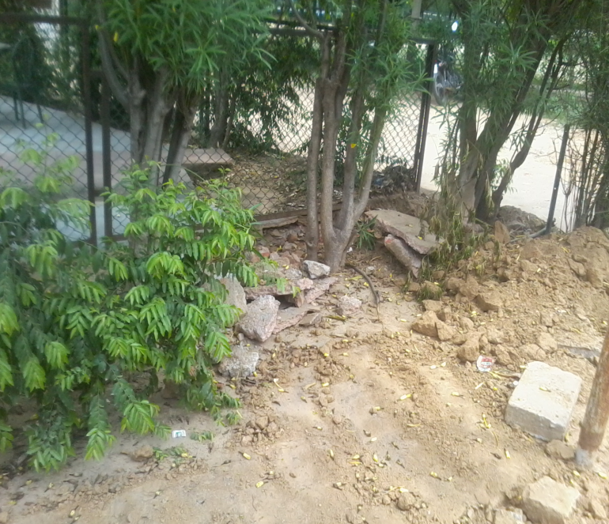

Slide 3

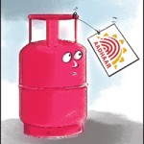
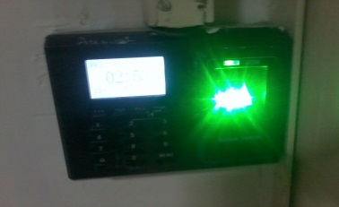
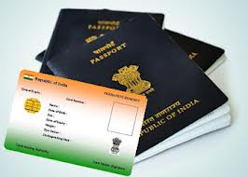
Innovative ideas
KYC (for both banks & LPG connections/re-filling) through Biometrics/AADHAAR
Lab security through biometrics
Using the ATM Machine
Filing/Processing Passport
Filling the Income tax return

Slide 4
OUR IDEA
Filling of KYC (Know Your Customer form for banks ) through Biometrics/ AADHAR Card.
Filling of KYC is made necessary by Government of India.
It will give us the accurate and authenticate information of the person.
It reduces human effort and is also helpful for illiterate people.

Slide 5
PROBLEM STATEMENT
Government needs Accurate Financial Record of all the Citizens of the Country for the:-
Transparency in Tax revenues.
No transaction of Black Money through Banks.
Reduction of Corruption .

Slide 6
Know Your Customer (KYC)
It refers to due diligence activities that financial institutions and other regulated companies must perform to ascertain relevant information from their clients for the purpose of doing business with them.
The term is also used to refer to the bank regulation which governs these activities.
KYC processes are also employed by companies of all sizes for the purpose of ensuring their proposed agents', consultants' or distributors' anti-bribery compliance. Banks, insurers and export credit agencies are increasingly demanding that customers provide detailed anti-corruption due diligence information, to verify their probity and integrity.

Slide 7
Benefits & Uses
Accurate financial records,
For anti-corruption due diligence information,
In preventing identity theft,
In preventing financial fraud,
In preventing money laundering,
In preventing terrorist financing,
In anti-bribery compliance etc.

Slide 8





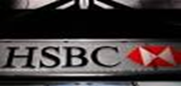
1) It is difficult to change the mentality of the people in order to sustain transparent system.
2) Most of the banks do not want KYC to be filled by their customer in order to their benefit.
The bank transactions would be transparent so that we know about all the money transactions. Acts of corruption can be reduced through this.
1)Quicker, efficient and reliable process
2)Reduction in human error
3)Even illiterate people can also fill their KYC due to this simple process
1) Politicians would try to stop this thing from implementation as it would curb their mal-practices
2) We cannot overcome this problem in the case of SWISS BANK (HSBC).
People are disappointed, sad, angry with the response of the government
and their style of working.

Slide 9
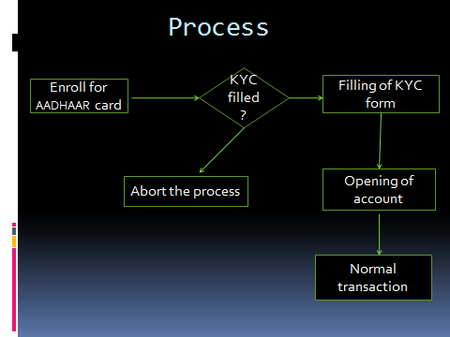

Slide 10
About Product
It will fill the KYC form automatically on one scanning from the QR scanner.
It will provide the right information based on AADHAAR Card.
The signature required in the form will be secured as a Thumb Impression given by a person on a Biometric Scanner(Finger Print Scanner).
It also has Eye scanner/Iris scanner for verification in case failure of Finger Print Scanner.

Slide 11
Technical Requirement
Large database to store the data of customers.
Finger print scanner and recognition software and hardware.
Eye scanner / Iris scanner.
Bar code reader to read AADHAAR card.

Slide 12
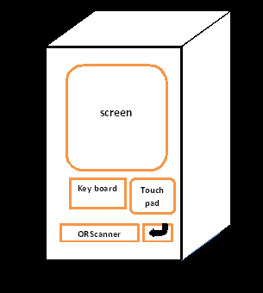
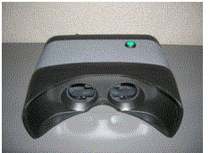
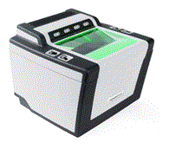
EQUIPMENT

Slide 13
FUTURE PROSPECTS
Customers having account in different banks have to fill up separate KYC forms.
We can extend this machine as a unlocking device i.e. a person can not do any banking transaction until & unless his/her KYC is filled.
contd…..

Slide 14
If KYC of a person is filled then this device will be used as a interconnecting device b/w all banks in which person’s account exist.
Any transaction made from any bank will be reported to government hence illegal flow of money can be controlled.

Slide 15
THANK YOU & REGARDS
GROUP 3
NAME | CATEGORY | INSTITUTE
AMOLAK PRASAD | 1st | Dayalbagh Educational Institute, Dayalbagh ,Agra
NEHA RAMKUCHE | 4th | Samrat Ashok Technological Institute
KRISHAN YADAV | 4th | Ansal Institute of Technology
SUMIT SINGH SANKHLA | 6th | The ICFAI University

Slide 16

QUERIES???

