Slide 1
MADHYAM
A MEDIUM TO CONNECT

Slide 2
Summary
Our organized maid service basically provides :-
Regular service by maids 24*7 hours in each house served by organization.
This relieves owner of house(specially working people) of tension whether the maid would be coming ?, whether she would come on time ?, is our home secure ?.
It works by convincing and adding all maids of a society under organization under 1 team, maintaining their background record , each maid with her own identity.
Any maid of a team can take urgent leave and in her place another maid that is free from work would serve that house for that time.
This would help maids to take paid leave, they would have fixed salary and better living conditions and esteem.
This thus satiates both owner and maid.
Though this system thus exist in Pune , Ahemdabad and also in Melbourne, yet our organization aims to target societies in cities that are ignored.

Slide 3
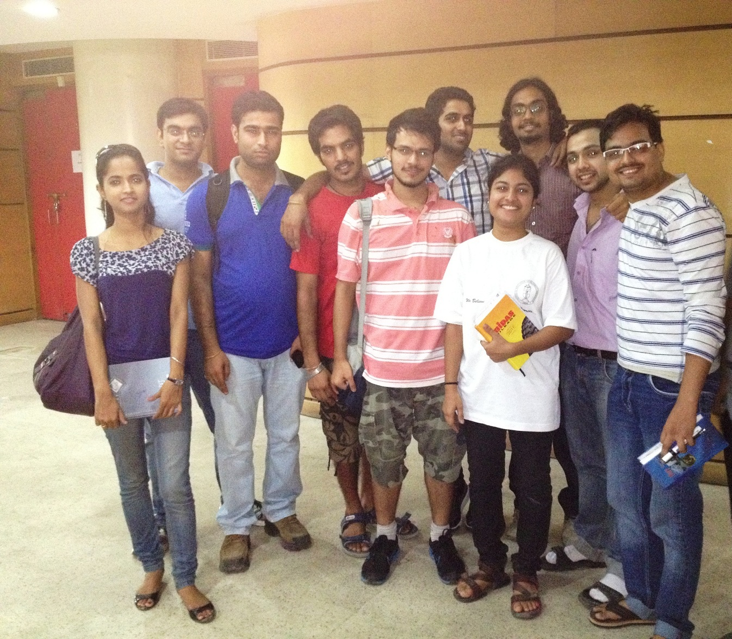
TEAM MEMBERS

Slide 4
TOP THREE IDEAS
Chalo Bai !!!
Producing Electricity Using Springs
Mechanical Charger

Slide 5

Producing Electricity Using Springs

Slide 6
Mechanical Charger
Mechanical charger converts mechanical energy provided into electricity energy which can be used to temporarily charge cell phone , camera.

Slide 7
PAIN AREA
An unorganized house maid Market

Slide 8
SIX THINKING HATS
BLUE HAT
Customers are not satisfied with the maids.
Maids are not happy with the job.
We have to find the solution for both the problems.

Slide 9
White Hat
Customers are unhappy because maids are
  Irregular
  Not Punctual
  Dishonest(Security issues)
  Giving Bad Quality of Service
  Misbehaving

Slide 10
Green Hat
Changing maid
Collect information about maid(Background check)
Scolding the maid for proper working
Regular communication
Organized maid service

Slide 11
Red Hat
Maid loses job
Maid morale is down
One cannot force anyone to do the work (in human).
Maid may be frustrated (that he/she is being doubted=(ego hurt))

Slide 12
Yellow Hat
Customer gets a better maid
Maid gets better work
Customer feel secure
Maid does better work
Better understanding.
Regularity , punctuality , security ,good quality work (for customer)
Job security , paid leaves , better and fixed salary , better working conditions (for maids )

Slide 13
BLACK HAT
No guarantee of getting maid / better maid
New maid demands more salary
Safety issues
Maid turns rebellious (may complain to police)
Maid doesn’t respond
Customer does not want to pay more
Customer doesn’t like new maid
100% security cannot be assured

Slide 14
BLUE HAT
Looking at all the solutions , having an Organized Maid Service will be beneficial for both customer and maid

Slide 15
Why to select this idea ?
IMPACT
Customer happy as service is regular and reliable
Maids are happy as they get a good fixed salary, paid leave & better working condition.

Slide 16
Why to select this idea ?
MARKET
Almost every house need a house maid.
Working people are main market as they have to go for work time and want their maids to come on time and regularly which is provided by our organization.
Every Customer faces problem such
  irregularity, lack of punctuality, uncalled leave , security etc.
COMPETITION
Competition exists as something similar to this (not exactly) exists in pune, ahemdabad but not in big scale.
The market being unorganized, we can have a first mover advantage .

Slide 17
STRATEGY TO GIVE REGULAR SERVICE
B
B
B
B
B
B
BAI ON HOLIDAY
B

Slide 18
Expansion
To expand on large scale
for professionals.

Slide 19

The standard is excellence

Slide 20
MAID ON CALL personnel are ready to care for the needs of busy professionals with demanding schedules.
Available 24 hours a day, 7 days a week
Prompt and courteous
Carefully screened
Bonded and insured
Skilled, specially trained
Uniformed
The standard is excellence

Slide 21
Among the services that
MAID ON CALL offers are:
General cleaning, deep cleaning
Laundry: wash and fold
Dry-Cleaning drop-off/pick-up.
Ironing and steaming
Cooking: planning, shopping, preparation of basic meals.
Food and drink servers
Gardening: maintenance of houseplants, outdoor flowers and trees
Specialty Services
Carpet Shampoo/ Furniture Cleaning
Dust Mite & Flee Treatment
Fire proofing
Rubbish Removal/Hauling
The standard is excellence

Slide 22
Maid On Call Personnel
Carefully screened, bonded and insured personnel for your safety and comfort.
Our Personnel attend a specially designed training program and attend ongoing learning programs to improve and to add to their ability to serve you.
Because of the benefits, training, and opportunities for advancement we offer our personnel, we are able to recruit and to retain the best available people for our staff.
The standard is excellence

Slide 23
Easy to use
Create your account online at www.maidoncall.com or through our toll free number 1800-MAIDONCALL
Once an account is opened, clients call our toll free number 1800-MAIDONCALL or place the order at online at www.maidoncall.com.
We can reply to service requests within 15 minutes and arrive at customer’s location within a short time.
When the order is placed, the customer will receive a confirmation of the order in the format that they choose: email, fax, call back or text message to their cell phone. Confirmation will include:
Original time of inquiry
Scope of work
Estimated charges
Name, ID number, and picture of maid dispatched
Estimated time of arrival
After the job is done a confirmation of hours worked, etc. will be sent by the same method.
The standard is excellence

Slide 24
BUSINESS PLAN
Organized Maid Service which is reliable, regular, secure and good quality service

Slide 25
Help needed to execute idea
Strategy
Market research required
Local people required to make the maids understand the system and to convince them

Slide 26
Help needed to execute idea
FINANCIAL HELP
Needed for research , staff wages , legal procedures
Needed for infrastructure at a later stage
MARKETING HELP
Not needed initially
Only word of mouth will be enough

Slide 27
CONCLUSION
By creating a company for organized maid services , the customers will get a regular and reliable service of trained maids and the maids will have a job with a good pay and good working conditions
Both the customers and the maids will be satisfied
PROBLEM SOLVED

Slide 28
LEADERSHIP LESSONS OF STEVE JOBS
Focus
Simplify
Take responsibility end to end
When behind, leapfrog
Put products before profits
Don’t be a slave to focus groups
Bend reality
Impute
Push for perfection
Tolerate only “A” players
Engage face to face
Know both the big picture and the details
Combine the humanities with the sciences
Stay hungry, stay foolish.

Slide 29
TEAM
Harish Lanka | COLLEGE OF ENGINEERING PUNE, PUNE
Pramod Saini | B K BIRLA INSTITUTE OF ENGINEERING & TECHNOLOGY, PILANI
Vyom Bhatt | SKS GROUP OF INSTITUTIONS, MATHURA
Uttkarsh Shandilya
Nancy Bansal | UNIVERSITY COLLEGE OF ENGINERING PUNJABI UNVERSITY, PATIALA
Rijul

