Slide 1
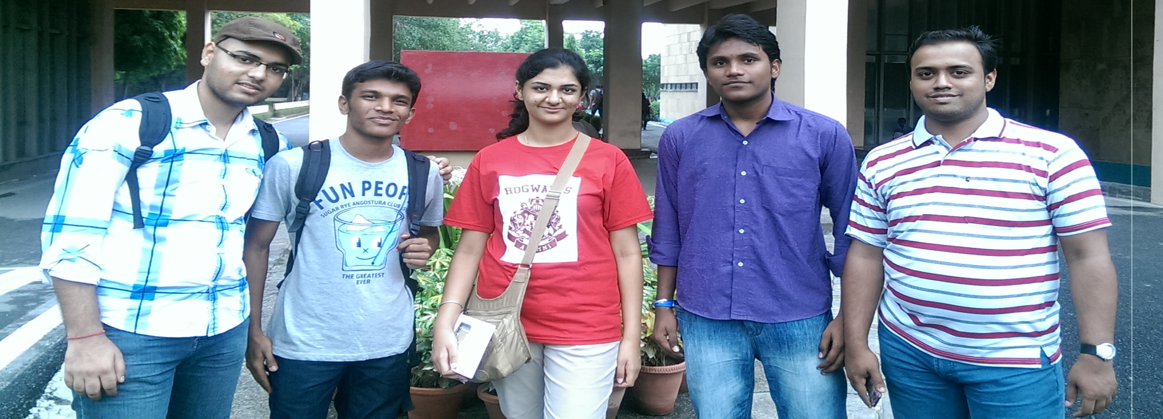
Divergent Doers Group 8
Rheeya Uppaal (TL)
Piyush Gupta
Sumedh Raut
T. Madhu Babu
Onkar Athalekar

Slide 2
The Ideas That Almost Made It!!!
Reusing and Recycling of Old & Scrap Cloths
Burger Cover
Portable Washing Machine

Slide 3
The Brick Wall – A problem Statement
Men need a shaving substitute while travelling because they tend to forget to carry a shaving kit or they find it inconvenient to carry the entire kit.

Slide 4
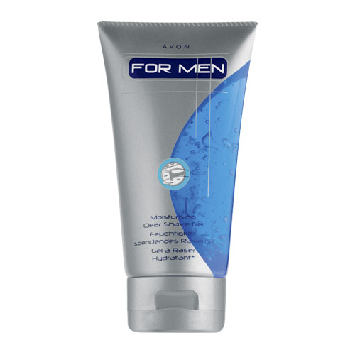
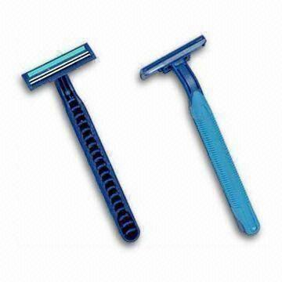
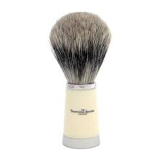
Your Solution – A New Kit

Slide 5
Our Innovation
Twin blade
Push button
Gel tube
Slit
Shaving brush

Slide 6
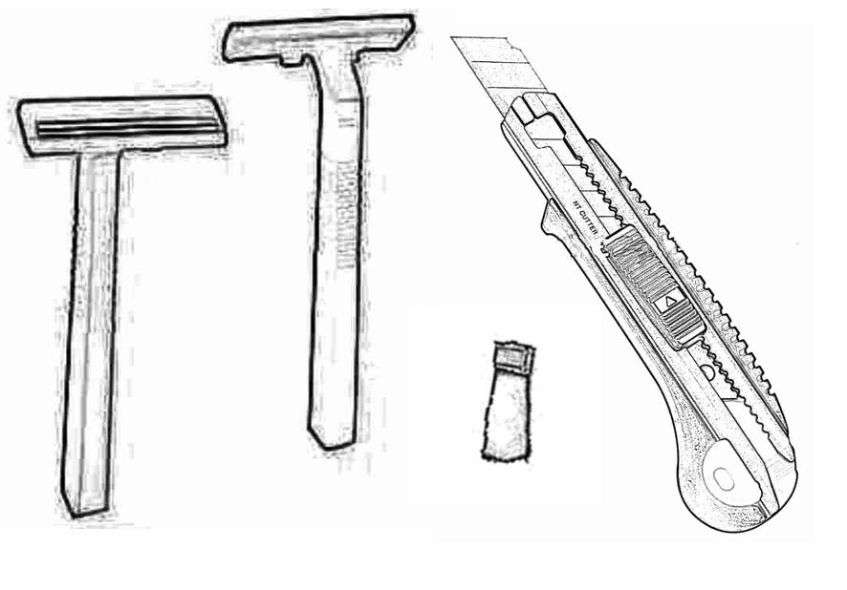
What Inspired Us???

Slide 7
Idea Consideration
IMPACT
Reducing cost and increasing convenience
MARKET
Consumers forgetting their shaving kits
Consumers who feel inconvenienced to carry shaving kits
Use and throw razor market
COMPETITION
Industry giants
Other use and throw razor manufacturers

Slide 8
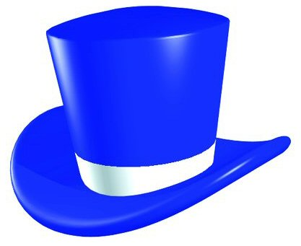
The Thinking Hats
Kept the team’s focus on the specifics of the product and the problem
Section of men forget to carry shaving kit while travelling
However, statistical data required
Sliding cutter mechanism
Integrated gel and brush
Can be extended to toothbrush and paste

Slide 9
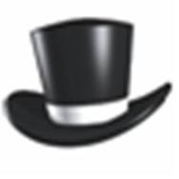
The Thinking Hats
3 in 1
Space efficient
Economic substitute for a new kit
Easy to manufacture
Disposable
Wide target audience
Uncertainty
Not beneficial for long term use
Small size of brush
Can alter the world of shaving for the better
Preferable for temporary use

Slide 10
SCAMPER
Substitute
Combine
Adapt
Modify/Magnify/Minify
Put to another use
Eliminate
Rearrange

Slide 11
The Execution Barriers
Finance
Funds
Collaboration
Marketing
Brand creation and management
Surveys and feedbacks required
Promotional strategy
Strategy
Penetration
Diversification

Slide 12
THANK YOU!!!

